Slide 1




Apply Dynamic Time Warping in Wearable Devices
By Yip Man Ho, Ho Ka Wa, Lee Sai Kit & Hui Hiu Yi
(Group n)
Notes:
(Greeting)
We are Group N
We are going to present our topic – Apply Dynamic Time Warping

Slide 2

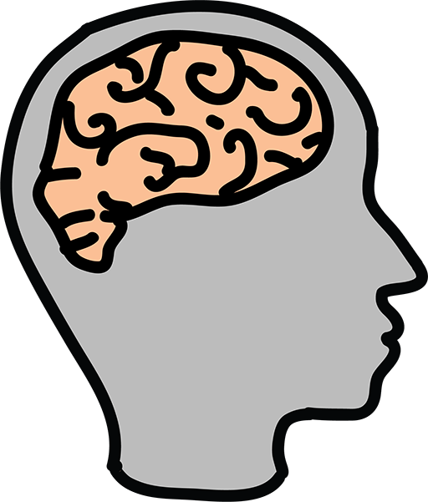

Introduction
???
???
UNKNOWN
ACTION
Notes:
How does a human identify an action? Eyes capture images -> images compared with actions in memory
How about computer? Same way?
See in a different way?
Alternative way – timeseries data from wearable device
For example, acceleration, heart-rate at different time unit
How similar?

Slide 3
Presentation Structure
Time Series Similarity
Dataset
Data Pre-processing
Classification (demo)
Notes:
In the presentation today...

Slide 4
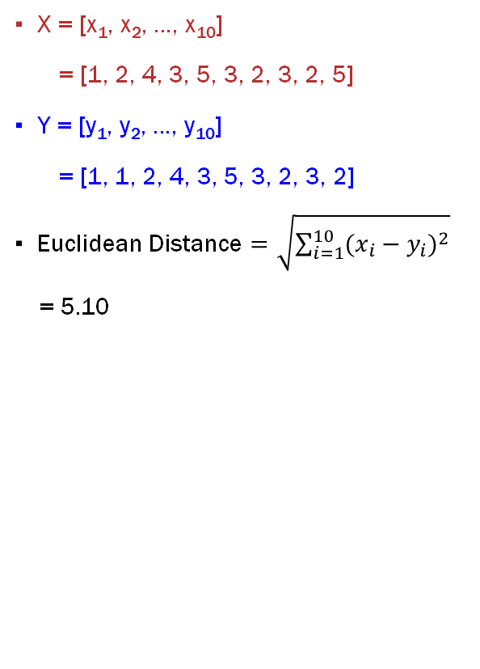
Time Series Similarity
X = [x₁, x₂, …, x₁₀]
= [1, 2, 4, 3, 5, 3, 2, 3, 2, 5]
Y = [y₁, y₂, …, y₁₀]
= [1, 1, 2, 4, 3, 5, 3, 2, 3, 2]
Euclidean Distance $=\sqrt{\sum_{i=1}^{10}{{(x_{i}−y_{i})}^{2}}}$
= 5.10
I love AI
Y is just slightly right shift of X but Euclidean Distance cannot reflect the similarity
I... I love AI
Notes:
A key issue is to measure similarity
Let say there are two time series X and Y
How do we measure the similarity between time series data?
Can we use Euclidean distance point by point?
For example, sound recording

Slide 5
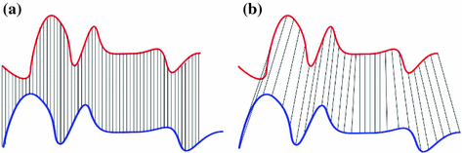
Time Series Similarity
? ? ?
Euclidean Distance
Dynamic Time Warping
Notes:
Can we compare the data across time units?
Focus on the shape but not point to point comparison

Slide 6
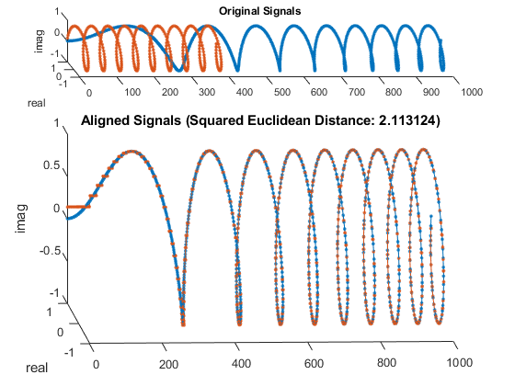
Dynamic Time Warping (DTW)
DTW is sexy
DTW~ is~ sexy~
Designed especially for time series analysis
Ignore SHIFTS in time dimension
Ignore SPEEDS of 2 time series
Warp time axis repeatedly until an optimal alignment found
Optimal alignment = Warp path with minimum distance
Scan to watch our video for more details
Notes:
Diagram: example of different speed / length
With DTW --> warped together
Optimal match between the two time series

Slide 7












Dataset
10 People
12 Actions
Standing (1 min) |  | Sitting & Relaxing (1 min) |  | Lying Down (1 min)
Walking (1 min) |  | Climbing Stairs (1 min) |  | Waist Bends Forward (20X)
Frontal Elevation of Arms (20X) |  | Knees Bending (20X) |  | Cycling (1 min)
Jogging (1 min) |  | Running (1 min) |  | Jump Front & Back (20X)
Notes:
I am Owen, before we get deep to methodology, I would like to talk about the dataset that we use. The dataset is collecting the action data from 10 different people. There are total 12 actions are labeled, they are all listed on the slide. For example, we have 1 minute duration of standing data, 1 minute data of walking, 20 times of Jumping Front & Back and so on. Every participant will do all these 12 actions in the same duration or frequency. Next, I will show you how these action data will be represented in computer data format.

Slide 8
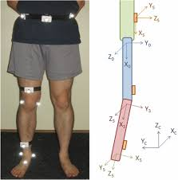
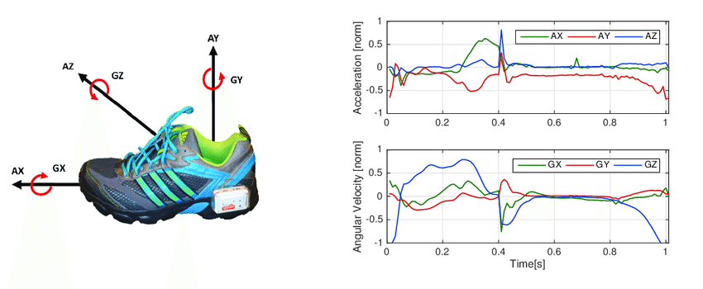
Dataset
3 Sensors: Chest, Right Lower Arm & Left Ankle
23 Features
Acceleration (m/s²)
Electrocardiogram Signal (mV)
Gyroscope – angle velocity (deg/s)
Magnetometer (local)
Notes:
For each person, they put 3 sensors on different part of body to collection action data. There are totally 23 features can be extracted from the sensors. And the form of collected data are acceleration, electrocardiogram, groscope which is the angle velocity and magnetometer is also recorded. For example, let's take a look at the shoes. The sensor is locating here to record the data I described before.

Slide 9
Methodology: Dataset Structure
23 Features
Subject
Label
1
.
.
.
2
.
.
.
1
2
.
.
12
1
2
.
.
12
275,151
Obs.
Master Set
9
.
.
.
10
.
.
1
2
.
12
1
2
.
68,044
Obs.
Test Set

Slide 10
Methodology: Data Splitting
Split Dataset​
Time series data - split by subject instead of randomly splitting
Assign 8 people to Master Set​ & 2 people to Test Set
Subjects must be assigned separately to either Master or Test Set
Master Set
Test Set

Slide 11
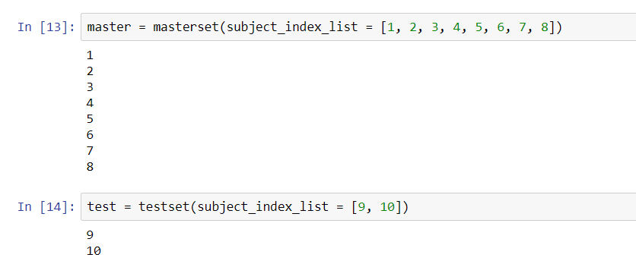
Methodology: Data Splitting
Split Dataset​
Time series data; split by subject instead of randomly splitting
Assign 8 People to Master Set​ & 2 people to Test Set
Subjects must be assigned separately to either Master or Test Set
Code: assign subjects 1 - 8 to Master Set & 9 - 10 to Test Set

Slide 12
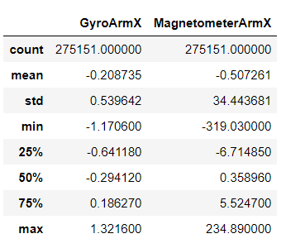
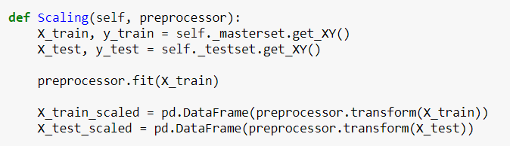
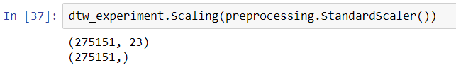
Methodology: Rescaling
Features with different scale:
Bias to the features with larger scale
Large contrast between scales of GyroArmX & MagnetometerArmX
Rescale features by Normalization
Z_{ij} = (X_{ij} - Mean of X_{i}) / S.D. of X_{i}
Code: Sklearn.preprocessing.StandardScaler()

Slide 13
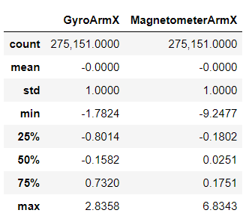
Methodology: Rescaling
After rescaling, features are in same scales with zero mean and one S.D.
Before rescaling
After rescaling

Slide 14
Methodology: Dimension Reduction
Why?
Rule of thumb: Prefer important but small no. of features rather than unimportant and large no. of features
Curse of dimensionality: Some supervised models such as multiple linear regression, it has assumptions that the no. of observations has to be more than no. of features
Collinearity: if Corr(A, B) = 0.99, A is simply equal to B. Thus, either A or B is used
Increase processing speed
Principal Component Analysis (PCA) is used to reduce dimension
23 Features
No. of Obs.
Master Set

Slide 15
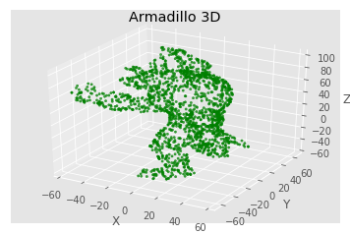
Methodology: Dimension Reduction
Principal Component Analysis (PCA)
Set complex mathematical formula aside, what is PCA?
We focus on application of PCA and explain its characteristics by our friend 3D Armadillo below
X = Depth
Y = Width
Z = Height

Slide 16
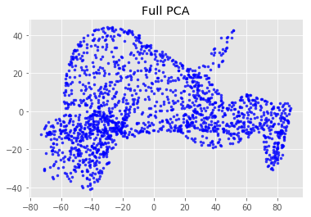
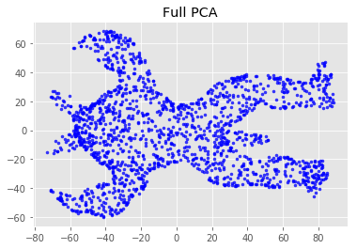
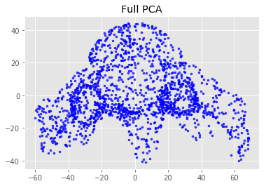
Methodology: Dimension Reduction
If we transform our friend 3D armadillo to a 2D image by using the first two principal components? How will it look like?
(a) a beach pic?
(b) a car accident pic?
or (c) an embarrassing pic?
X = Depth
Y = Width
Z = Height

Slide 17
Methodology: Dimension Reduction
Through this question, we understand the characteristics of PCA are that
If we have 3 features, we will have 3 corresponding principal components (p.c.)
PCA will prioritize principal components by the volume of information they contain
Height factor contains the most information, then width factor. Depth factor contain the least information.
X = 1st comp; Y = 2nd comp
X = 1st comp; Y = 3rd comp
X = 2nd comp; Y = 3rd comp

Slide 18
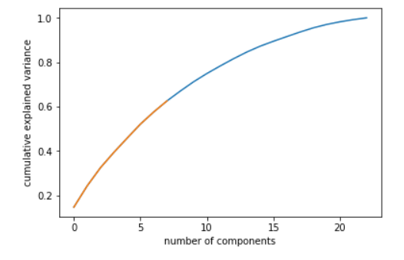
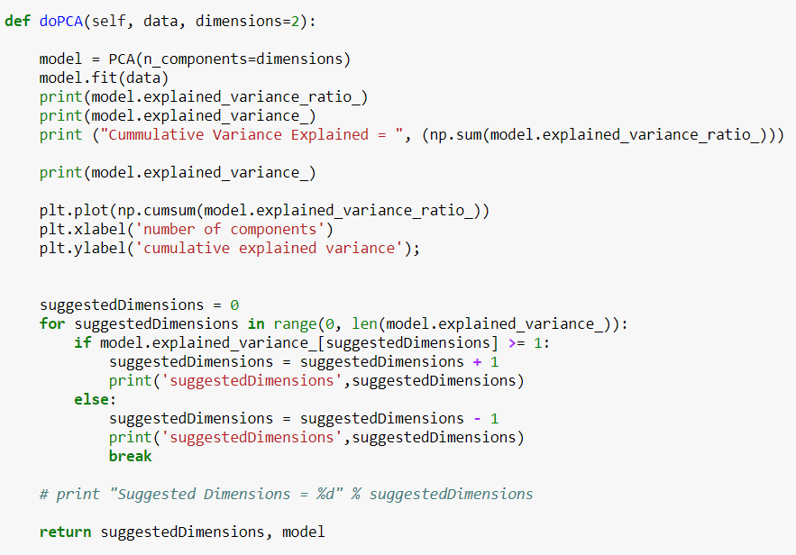
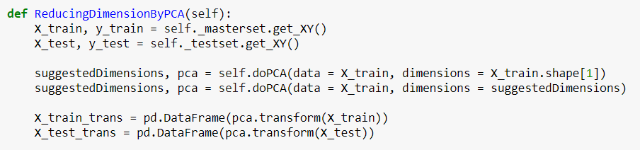
Methodology: Dimension Reduction
PCA :
First 8 components are selected because their explained variance are over one
They explain 62% of cumulative variance
After reducing dimension, 23 features
have been transformed to 8 factors
Code: sklearn.decomposition.PCA()

Slide 19
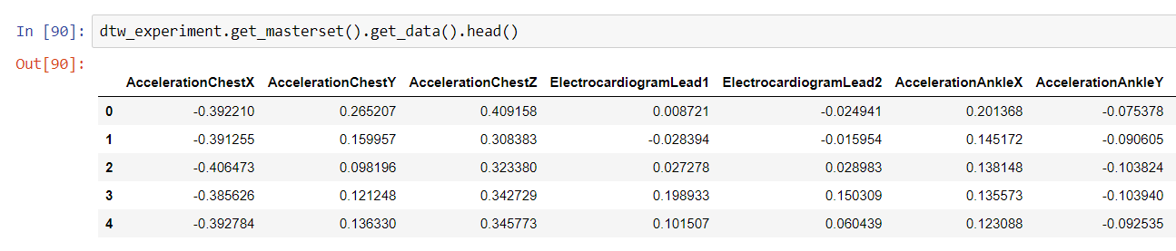
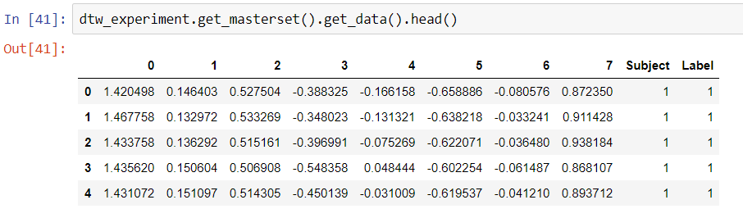
Methodology: Dimension Reduction
After reducing dimension, 23 features have been transformed to 8 factors
Before reducing dimension
After reducing dimension

Slide 20
Methodology: Dataset Description
8 Factors
Subject
Label
1
.
.
.
2
.
.
.
1
2
.
.
12
1
2
.
.
12
275,151
Obs.
Master Set
9
.
.
.
10
.
.
1
2
.
12
1
2
.
68,044
Obs.
Test Set

Slide 21
Methodology: Classification by DTW
An unknown action 3 of subject 9 in test set (but we know the action is lying down)
Use DTW to find distance between the unknown action and 12 actions of subject 1 from master set
Master Set
Test Set
V.S.
?

Slide 22
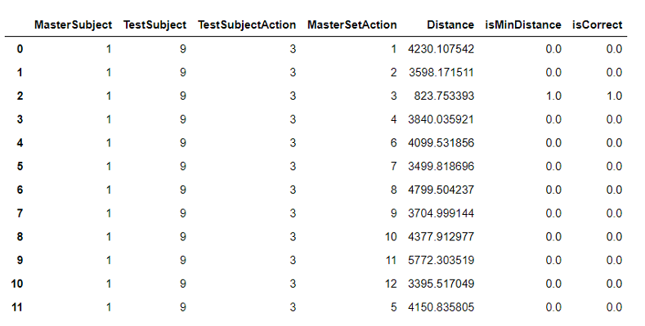
Methodology: Classification by DTW
An unknown action 3 of subject 9 in test set (but we know the action is lying down)
Use DTW to find distance between the unknown action and 12 actions of subject 1 from master set

Slide 23
Methodology: Classification by DTW
Repeat same steps and find distances between 12 actions of subject 2 & the unknown action of subject 9
Master Set
Test Set
V.S.
?

Slide 24
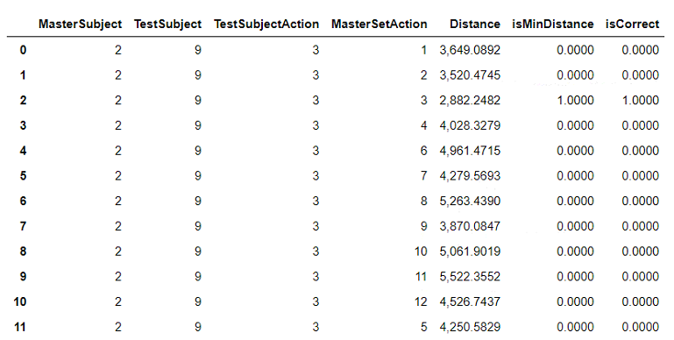
Methodology: Classification by DTW
Repeat same steps and find distances between 12 actions of subject 2 & the unknown action of subject 9

Slide 25
Methodology: Classification by DTW
And Subject 3
Until…
Master Set
Test Set
V.S.
?

Slide 26
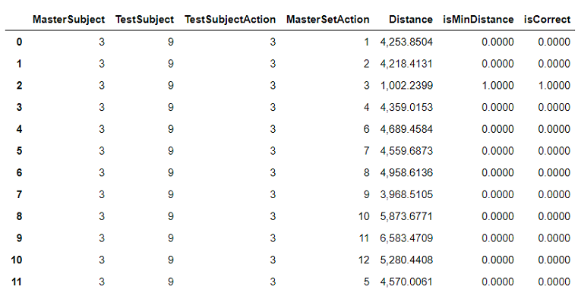
Methodology: Classification by DTW
And Subject 3
Until…

Slide 27
Methodology: Classification by DTW
The last subject 8 in Master Set
Master Set
Test Set
V.S.
?

Slide 28
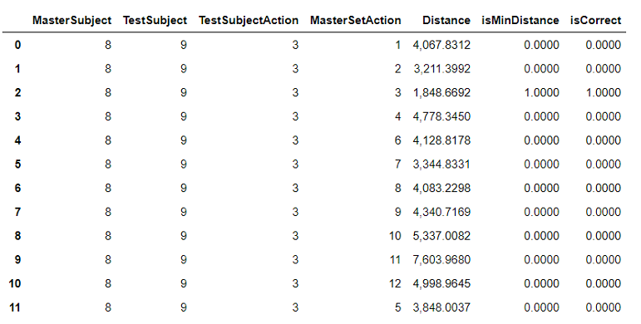
Methodology: Classification by DTW
The last subject 8 in Master Set

Slide 29
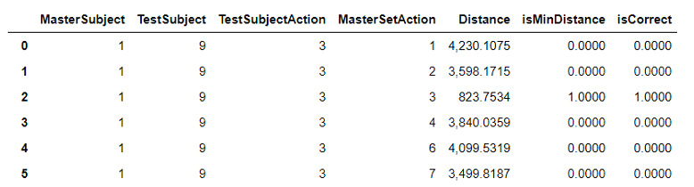
Methodology: Classification by DTW
Finally we have the distances between the unknown action of subject 9 in Test Set and all 12 actions of all 8 subjects in Master Set

Slide 30
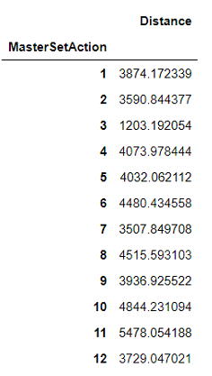
Methodology: Classification by DTW
Predict an unknown action:
Finally we have the distances between the unknown action of subject 9 in Test set and the 12 actions of all 8 subjects in Master Set
Get average distance of all 12 actions
Action 3 has a shortest mean distance
Therefore, we predict that the unknown action
is action 3
?
=

Slide 31

Methodology: Classification by DTW
Repeat same steps for remaining actions of the 2 subjects in Test Set
Test Set
✓

Slide 32
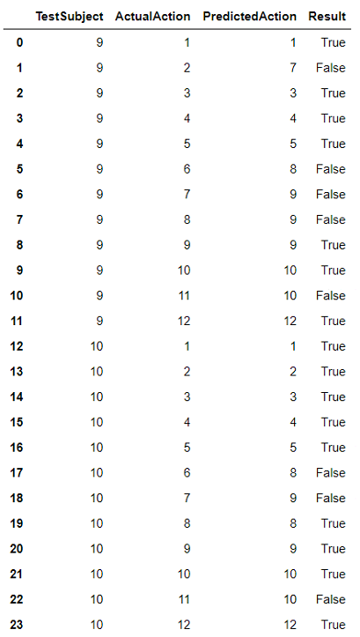
Methodology: Classification by DTW
Validation:
Repeat same steps for remaining actions of the 2 subjects in Test Set
Accuracy score = 0.625

Slide 33
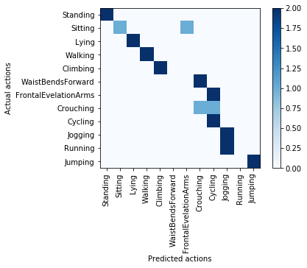
Methodology: Classification by DTW
Validation Results
Confusion Matrix
DTW can be used for classification problems
DTW does a pretty good job at identifying actions including standing, lying down, walking, climbing, cycling, jogging and jumping.
Some actions such as WaistBendsForward and FrontalEvelationArms are difficult to be identified by DTW

Slide 34
Findings
Deficiencies
Possible Improvements
Small Data Set: Only 10 people
It takes time to get DTW results
The accuracy can probably be improved by increasing number of subjects in master set and the number of observations used
Cross validation is expected to be used
Rank / weight of features according to actions

Slide 35
Our Work
Github link of source code:
https://github.com/owen2801/comp7404-grpN
YouTube link of alternative presentation:
https://www.youtube.com/watch?v=tfOevFKQIjQ

Slide 36
References
mHealth DataSet from UC Irvine Machine Learning Repository
http://archive.ics.uci.edu/ml/datasets/mhealth+dataset
FastDTW: DTW Algorithm with Time & Memory Complexity O(N)
https://pypi.python.org/pypi/fastdtw
Wikipedia – Dynamic Time Warping
https://en.wikipedia.org/wiki/Dynamic_time_warping
FastDTW: Toward Accurate Dynamic Time Warping in Linear Time and Space by Stan Salvador and Philip Chan
MathWorks – DTW
https://www.mathworks.com/help/signal/ref/dtw.html

Slide 37
References
mHealth DataSet from UC Irvine Machine Learning Repository
http://archive.ics.uci.edu/ml/datasets/mhealth+dataset
scikit learn – Preprocessing Data
http://scikit-learn.org/stable/modules/preprocessing.html
scikit learn - Principal Component Analysis
http://scikit-learn.org/stable/modules/generated/sklearn.decomposition.PCA.html#sklearn.decomposition.PCA

Slide 38
Q&A
https://www.instagram.com/animalove.co/

Slide 39

Methodology: Data Cleaning
Apart from Label 1 – 12…
There is Label 0 (Idle movement)
Remove Label 0 from the dataset
Standing (1 min) |  | Sitting & Relaxing (1 min) |  | Lying Down (1 min)
Walking (1 min) |  | Climbing Stairs (1 min) |  | Waist Bends Forward (20X)
Frontal Elevation of Arms (20X) |  | Knees Bending (20X) |  | Cycling (1 min)
Jogging (1 min) |  | Running (1 min) |  | Jump Front & Back (20X)

Slide 40
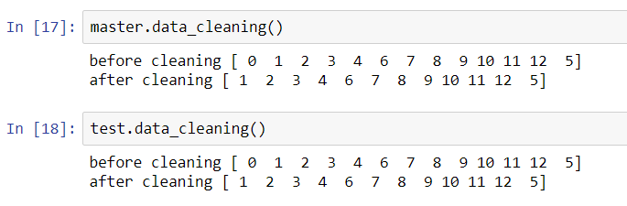
Methodology: Data Cleaning
There is Label 0 (Idle movement)
Remove Label 0 from the dataset
Code: data_cleaning() to remove Label 0

Slide 41
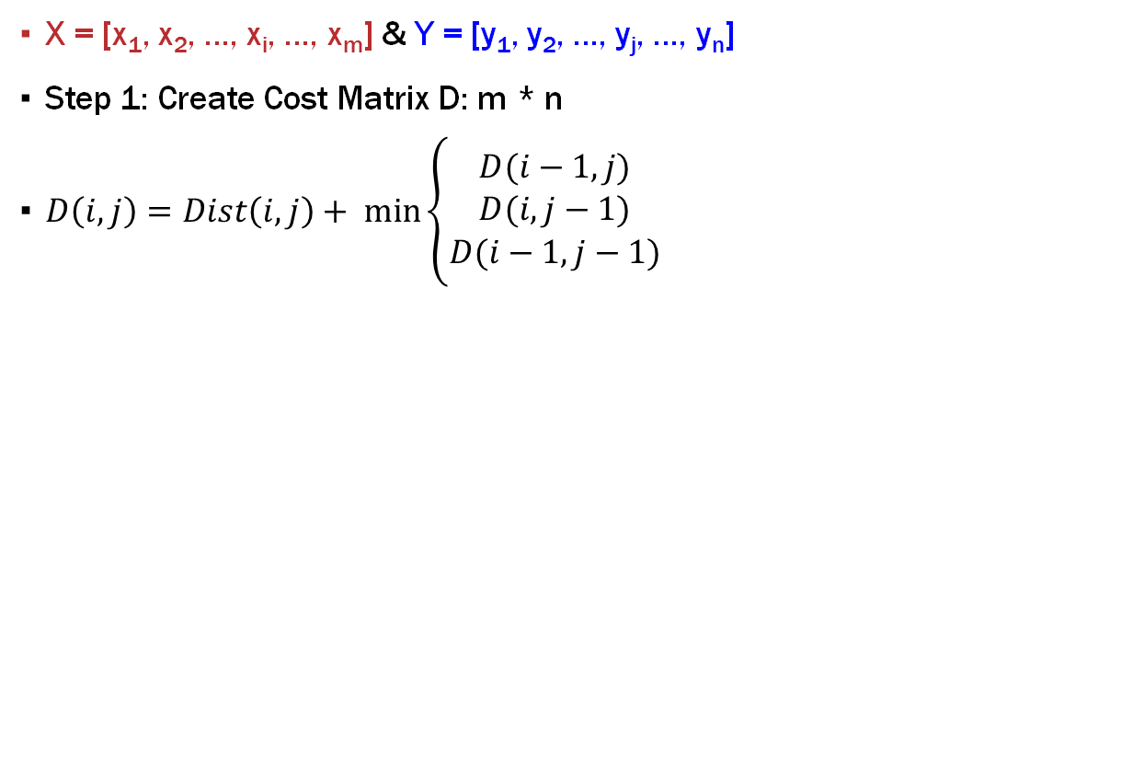
How DTW Works?
X = [x₁, x₂, …, x_{i}, …, x_{m}] & Y = [y₁, y₂, …, y_{j}, …, y_{n}]
Step 1: Create Cost Matrix D: m * n
$D\left(i,j\right)=Dist\left(i,j\right)+ \min_{}\left\{\begin{aligned}D(i−1, j) \\ D(i,j−1) \\ D(i−1, j−1)\end{aligned}\right.$
n
.
.
j
.
.
.
.
2
1
 | 1 | 2 | . | . | i | . | . | . | . | m

Slide 42
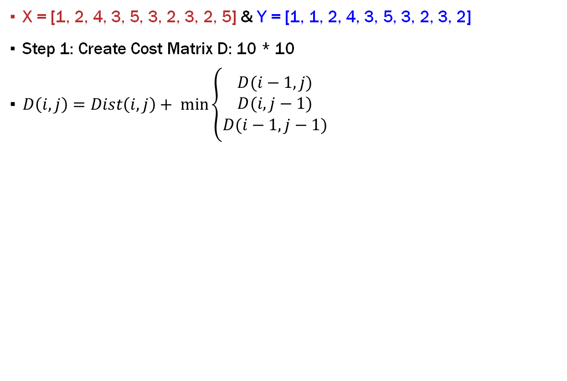
How DTW Works?
X = [1, 2, 4, 3, 5, 3, 2, 3, 2, 5] & Y = [1, 1, 2, 4, 3, 5, 3, 2, 3, 2]
Step 1: Create Cost Matrix D: 10 * 10
$D\left(i,j\right)=Dist\left(i,j\right)+ \min_{}\left\{\begin{aligned}D(i−1, j) \\ D(i,j−1) \\ D(i−1, j−1)\end{aligned}\right.$
2
3
2
3
5
3
4
2
1
1
 | 1 | 2 | 4 | 3 | 5 | 3 | 2 | 3 | 2 | 5

Slide 43
How DTW Works?
X = [1, 2, 4, 3, 5, 3, 2, 3, 2, 5] & Y = [1, 1, 2, 4, 3, 5, 3, 2, 3, 2]
Step 1: Create Cost Matrix D: 10 * 10
$D\left(i,j\right)=Dist\left(i,j\right)+ \min_{}\left\{\begin{aligned}D(i−1, j) \\ D(i,j−1) \\ D(i−1, j−1)\end{aligned}\right.$
D(1,5) = Dist(1,5) + D(1,4)
= |1-3| + 4 = 6
2 | 16
3 | 15
2 | 13
3 | 12
5 | 10
3 | 6
4 | 4
2 | 1
1 | 0
1 | 0
 | 1 | 2 | 4 | 3 | 5 | 3 | 2 | 3 | 2 | 5

Slide 44
How DTW Works?
X = [1, 2, 4, 3, 5, 3, 2, 3, 2, 5] & Y = [1, 1, 2, 4, 3, 5, 3, 2, 3, 2]
Step 1: Create Cost Matrix D: 10 * 10
$D\left(i,j\right)=Dist\left(i,j\right)+ \min_{}\left\{\begin{aligned}D(i−1, j) \\ D(i,j−1) \\ D(i−1, j−1)\end{aligned}\right.$
D(5,3) = Dist(5,3) + Min{D(4,2), D(5,2), D(4,3)}
= |5-2| + Min(6, 10, 3) = 6
2 | 16 | 8 | 8 | 4 | 6 | 2 | 1 | 1 | 0 | 3
3 | 15 | 8 | 6 | 3 | 5 | 1 | 1 | 0 | 1 | 3
2 | 13 | 7 | 5 | 3 | 5 | 1 | 0 | 1 | 1 | 4
3 | 12 | 7 | 3 | 2 | 2 | 0 | 1 | 1 | 2 | 4
5 | 10 | 6 | 2 | 2 | 0 | 2 | 5 | 5 | 6 | 4
3 | 6 | 3 | 1 | 0 | 2 | 2 | 3 | 3 | 4 | 6
4 | 4 | 2 | 0 | 1 | 2 | 3 | 5 | 6 | 8 | 9
2 | 1 | 0 | 2 | 3 | 6 | 7 | 7 | 8 | 8 | 11
1 | 0 | 1 | 4 | 6 | 10 | 12 | 13 | 15 | 16 | 20
1 | 0 | 1 | 4 | 6 | 10 | 12 | 13 | 15 | 16 | 20
 | 1 | 2 | 4 | 3 | 5 | 3 | 2 | 3 | 2 | 5

Slide 45
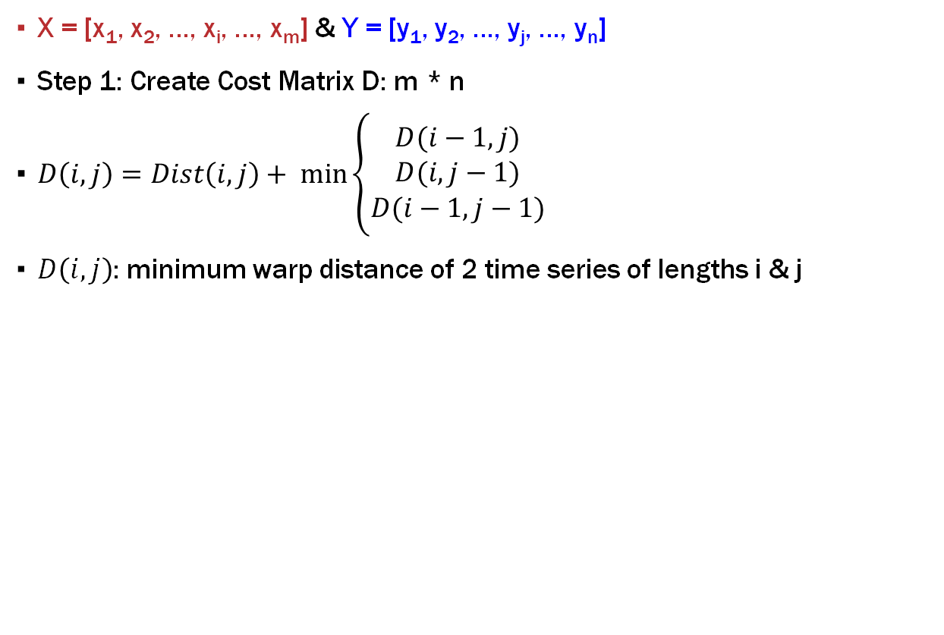
How DTW Works?
X = [x₁, x₂, …, x_{i}, …, x_{m}] & Y = [y₁, y₂, …, y_{j}, …, y_{n}]
Step 1: Create Cost Matrix D: m * n
$D\left(i,j\right)=Dist\left(i,j\right)+ \min_{}\left\{\begin{aligned}D(i−1, j) \\ D(i,j−1) \\ D(i−1, j−1)\end{aligned}\right.$
$D\left(i,j\right)$: minimum warp distance of 2 time series of lengths i & j
n
.
.
j | 12 | 7 | 3 | 2 | 2
. | 10 | 6 | 2 | 2 | 0
. | 6 | 3 | 1 | 0 | 2
. | 4 | 2 | 0 | 1 | 2
. | 1 | 0 | 2 | 3 | 6
2 | 0 | 1 | 4 | 6 | 10
1 | 0 | 1 | 4 | 6 | 10
 | 1 | 2 | . | . | i | . | . | . | . | m

Slide 46
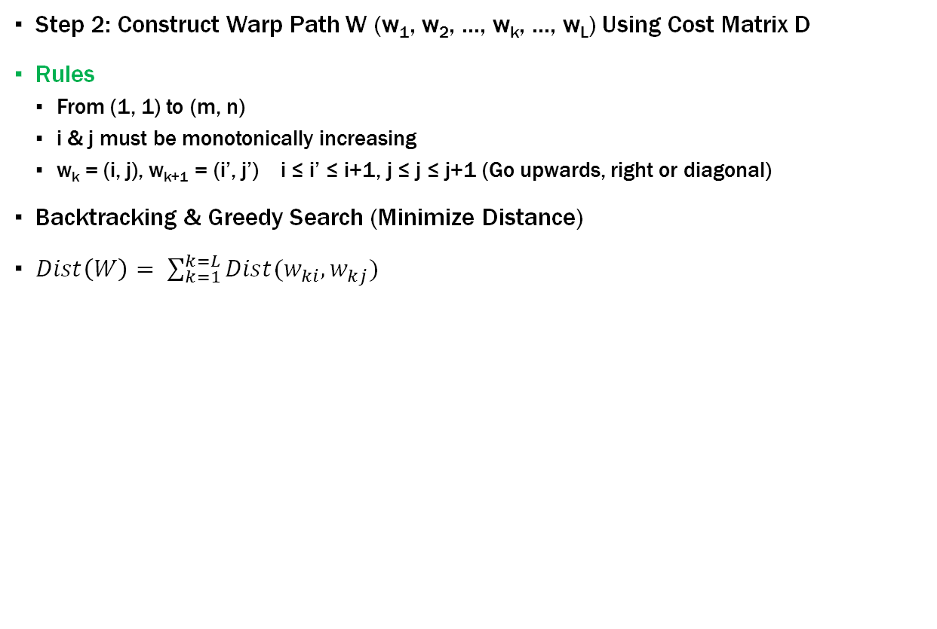
How DTW Works?
Step 2: Construct Warp Path W (w₁, w₂, …, w_{k}, …, w_{L}) Using Cost Matrix D
Rules
From (1, 1) to (m, n)
i & j must be monotonically increasing
w_{k} = (i, j), w_{k+1} = (i’, j’) i ≤ i’ ≤ i+1, j ≤ j ≤ j+1 (Go upwards, right or diagonal)
Backtracking & Greedy Search (Minimize Distance)
$Dist\left(W\right)= \sum_{k=1}^{k=L}{Dist(w_{ki},w_{kj})}$
n
.
.
j
.
.
.
.
2
1
 | 1 | 2 | . | . | i | . | . | . | . | m

Slide 47
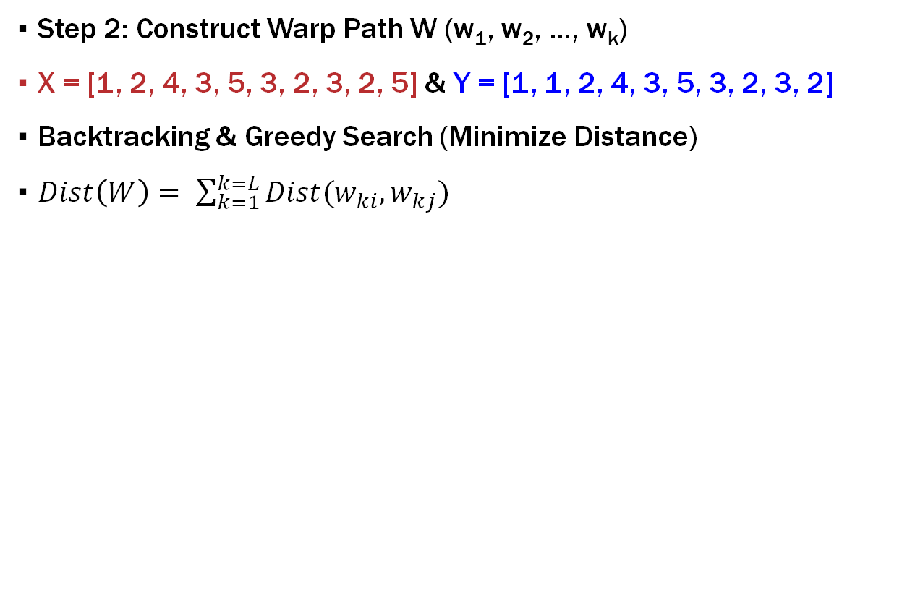
How DTW Works?
Step 2: Construct Warp Path W (w₁, w₂, …, w_{k})
X = [1, 2, 4, 3, 5, 3, 2, 3, 2, 5] & Y = [1, 1, 2, 4, 3, 5, 3, 2, 3, 2]
Backtracking & Greedy Search (Minimize Distance)
$Dist\left(W\right)= \sum_{k=1}^{k=L}{Dist(w_{ki},w_{kj})}$
2 | 16 | 8 | 8 | 4 | 6 | 2 | 1 | 1 | 0 | 3
3 | 15 | 8 | 6 | 3 | 5 | 1 | 1 | 0 | 1 | 3
2 | 13 | 7 | 5 | 3 | 5 | 1 | 0 | 1 | 1 | 4
3 | 12 | 7 | 3 | 2 | 2 | 0 | 1 | 1 | 2 | 4
5 | 10 | 6 | 2 | 2 | 0 | 2 | 5 | 5 | 6 | 4
3 | 6 | 3 | 1 | 0 | 2 | 2 | 3 | 3 | 4 | 6
4 | 4 | 2 | 0 | 1 | 2 | 3 | 5 | 6 | 8 | 9
2 | 1 | 0 | 2 | 3 | 6 | 7 | 7 | 8 | 8 | 11
1 | 0 | 1 | 4 | 6 | 10 | 12 | 13 | 15 | 16 | 20
1 | 0 | 1 | 4 | 6 | 10 | 12 | 13 | 15 | 16 | 20
 | 1 | 2 | 4 | 3 | 5 | 3 | 2 | 3 | 2 | 5

Slide 48
How DTW Works?
Step 2: Construct Warp Path W (w₁, w₂, …, w_{k})
X = [1, 2, 4, 3, 5, 3, 2, 3, 2, 5] & Y = [1, 1, 2, 4, 3, 5, 3, 2, 3, 2]
Backtracking & Greedy Search (Minimize Distance)
$Dist\left(W\right)= \sum_{k=1}^{k=L}{Dist(w_{ki},w_{kj})}$
2 | 16 | 8 | 8 | 4 | 6 | 2 | 1 | 1 | 0 | 3
3 | 15 | 8 | 6 | 3 | 5 | 1 | 1 | 0 | 1 | 3
2 | 13 | 7 | 5 | 3 | 5 | 1 | 0 | 1 | 1 | 4
3 | 12 | 7 | 3 | 2 | 2 | 0 | 1 | 1 | 2 | 4
5 | 10 | 6 | 2 | 2 | 0 | 2 | 5 | 5 | 6 | 4
3 | 6 | 3 | 1 | 0 | 2 | 2 | 3 | 3 | 4 | 6
4 | 4 | 2 | 0 | 1 | 2 | 3 | 5 | 6 | 8 | 9
2 | 1 | 0 | 2 | 3 | 6 | 7 | 7 | 8 | 8 | 11
1 | 0 | 1 | 4 | 6 | 10 | 12 | 13 | 15 | 16 | 20
1 | 0 | 1 | 4 | 6 | 10 | 12 | 13 | 15 | 16 | 20
 | 1 | 2 | 4 | 3 | 5 | 3 | 2 | 3 | 2 | 5

Slide 49
How DTW Works?
Step 2: Construct Warp Path W (w₁, w₂, …, w_{k})
X = [1, 2, 4, 3, 5, 3, 2, 3, 2, 5] & Y = [1, 1, 2, 4, 3, 5, 3, 2, 3, 2]
Backtracking & Greedy Search (Minimize Distance)
$Dist\left(W\right)= \sum_{k=1}^{k=L}{Dist(w_{ki},w_{kj})}$
2 | 16 | 8 | 8 | 4 | 6 | 2 | 1 | 1 | 0 | 3
3 | 15 | 8 | 6 | 3 | 5 | 1 | 1 | 0 | 1 | 3
2 | 13 | 7 | 5 | 3 | 5 | 1 | 0 | 1 | 1 | 4
3 | 12 | 7 | 3 | 2 | 2 | 0 | 1 | 1 | 2 | 4
5 | 10 | 6 | 2 | 2 | 0 | 2 | 5 | 5 | 6 | 4
3 | 6 | 3 | 1 | 0 | 2 | 2 | 3 | 3 | 4 | 6
4 | 4 | 2 | 0 | 1 | 2 | 3 | 5 | 6 | 8 | 9
2 | 1 | 0 | 2 | 3 | 6 | 7 | 7 | 8 | 8 | 11
1 | 0 | 1 | 4 | 6 | 10 | 12 | 13 | 15 | 16 | 20
1 | 0 | 1 | 4 | 6 | 10 | 12 | 13 | 15 | 16 | 20
 | 1 | 2 | 4 | 3 | 5 | 3 | 2 | 3 | 2 | 5

Slide 50
Dataset
3 Sensors: Chest, Right Lower Arm & Left Ankle
23 Features
Acceleration from Chest Sensor (X, Y & Z Axies)
Electrocardiogram Signal (Lead 1 & 2)
Gyroscope , Magnetometer & Acceleration from Left-Ankle Sensor (X, Y & Z Axies)
Gyro, Magnetometer & Acceleration from Right Lower Arm Sensor (X, Y & Z Axies)
*Units: Acceleration (m/s²), Gyroscope (deg/s), Magnetic field (local), ecg (mV)

Slide 51
How DTW Works?
Step 2: Construct Warp Path W (w₁, w₂, …, w_{k})
X = [1, 2, 4, 3, 5, 3, 2, 3, 2, 5] & Y = [1, 1, 2, 4, 3, 5, 3, 2, 3, 2]
Backtracking & Greedy Search (Minimize Distance)
$Dist\left(W\right)= \sum_{k=1}^{k=L}{Dist(w_{ki},w_{kj})}$
2 | 16 | 8 | 8 | 4 | 6 | 2 | 1 | 1 | 0 | 3
3 | 15 | 8 | 6 | 3 | 5 | 1 | 1 | 0 | 1 | 3
2 | 13 | 7 | 5 | 3 | 5 | 1 | 0 | 1 | 1 | 4
3 | 12 | 7 | 3 | 2 | 2 | 0 | 1 | 1 | 2 | 4
5 | 10 | 6 | 2 | 2 | 0 | 2 | 5 | 5 | 6 | 4
3 | 6 | 3 | 1 | 0 | 2 | 2 | 3 | 3 | 4 | 6
4 | 4 | 2 | 0 | 1 | 2 | 3 | 5 | 6 | 8 | 9
2 | 1 | 0 | 2 | 3 | 6 | 7 | 7 | 8 | 8 | 11
1 | 0 | 1 | 4 | 6 | 10 | 12 | 13 | 15 | 16 | 20
1 | 0 | 1 | 4 | 6 | 10 | 12 | 13 | 15 | 16 | 20
 | 1 | 2 | 4 | 3 | 5 | 3 | 2 | 3 | 2 | 5

Slide 52
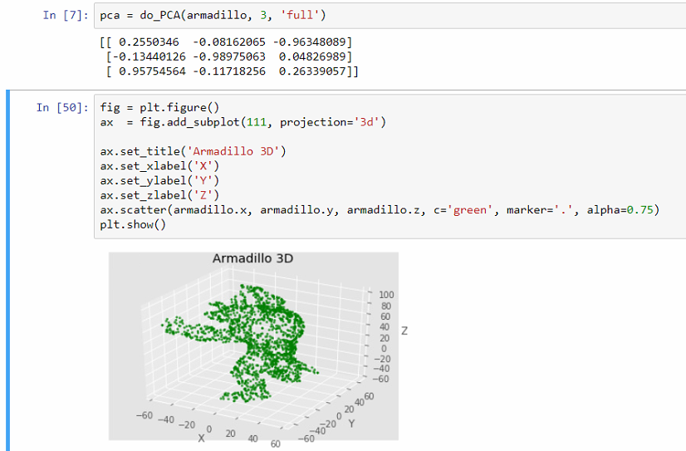

Slide 53
